Slide 1
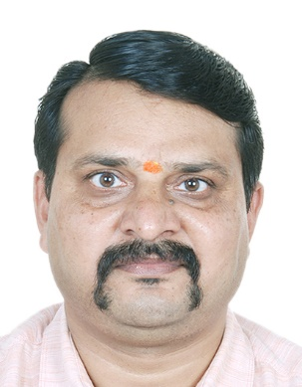
Energy and Environment Engineering
Dr K D Yadav
Associate Professor
Environmental Section
Department of Civil Engineering
S. V. National Institute of Technology, Surat
Mobile: +91-9428398266
E mail: kdy@ced.svnit.ac.in

Slide 2
Energy and Environmental Engineering CEME106
ENVIRONMENT AND ECOSYSTEMS
Introduction: Concept of an ecosystem- structure and functions of ecosystem. Components of ecosystem - producers, consumers, decomposers, Food chains, food webs, ecological pyramids, Energy flow in ecosystem. Bio-geo- chemical cycles, Hydrologic cycle Components of Environment and their relationship, Impact of technology on environment, Environmental degradation. Environmental planning of urban network services such as water supply, sewerage, solid waste management.
ENVIRONMENTAL POLLUTION
Water, air, soil, noise, thermal and radioactive, marine pollution: sources, effects and engineering control strategies. Drinking water quality and standards, Ambient air and noise quality standards
GLOBAL ENVIRONMENTAL ISSUES AND ITS MANAGEMENT
Engineering aspects of climate change. Acid rain, depletion of ozone layer. Concept of carbon credit. Concepts of Environmental impact assessment and Environmental audit. Environmental life cycle assessment

Slide 3
Solid Waste Management

Slide 4
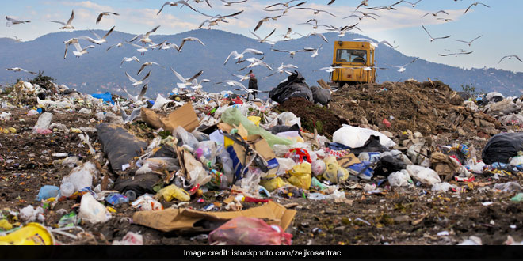
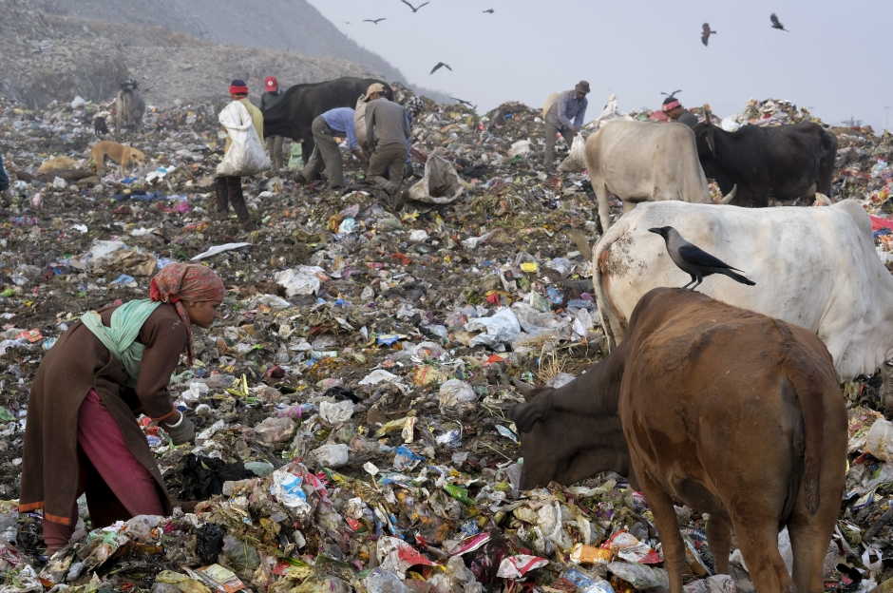
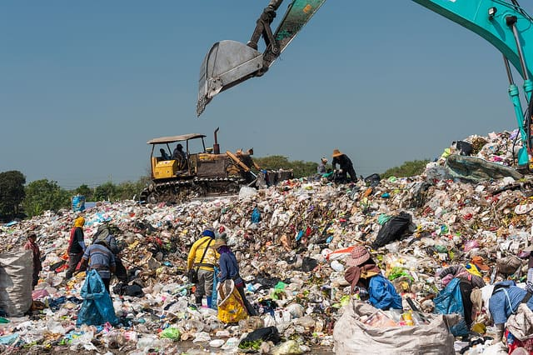

Slide 5
Waste Any material which is not needed by the owner, producer or processor. Waste is anything which does not add value to a product or service in any activity

Slide 6
Depending on their physical state they are classified as:
Liquid wastes: wastes in liquid form
Example: domestic washings, chemicals, oils, waste water from ponds, manufacturing industries and other sources.
Solid wastes: wastes in solid forms, domestic, commercial and industrial wastes
Examples: plastics, styrofoam containers, bottles, cans, papers, scrap iron, and other trash
Solid waste: Solid waste is the unwanted or useless solid materials generated from combined residential, industrial and commercial activities in a given area.
Solid waste management is the process of collection, transportation and disposal of solid waste in a systematic, economic and hygienic manner.
6

Slide 7
Classification of Solid Waste
Based upon their origin and type
Residential wastes
Commercial wastes
Institutional waste
Municipal wastes
Industrial wastes
Agricultural wastes
Based on their properties:
Biodegradable
Non-biodegradable
Based on their effects on Human Health and the Environment
Hazardous
Non-Hazardous
7

Slide 8
Classification of wastes according to their origin and type
Municipal Solid wastes: Solid wastes that include household garbage, rubbish, construction & demolition debris, sanitation residues, packaging materials, trade refuges etc. are managed by any municipality.
Bio-medical wastes: Solid or liquid wastes including containers, intermediate or end products generated during diagnosis, treatment & research activities of medical sciences.
Industrial wastes: Liquid and solid wastes that are generated by manufacturing & processing units of various industries like chemical, petroleum, coal, metal gas, sanitary & paper etc.
Agricultural wastes: Wastes generated from farming activities. These substances are mostly biodegradable.
Fishery wastes: Wastes generated due to fishery activities. These are extensively found in coastal & estuarine areas.
Radioactive wastes: Waste containing radioactive materials. Usually these are byproducts of nuclear processes. Sometimes industries that are not directly involved in nuclear activities, may also produce some radioactive wastes, e.g. radio-isotopes, chemical sludge etc.
E-wastes: Electronic wastes generated from any modern establishments. They may be described as discarded electrical or electronic devices. Some electronic scrap components, such as CRTs, may contain contaminants such as Pb, Cd, Be or brominated flame retardants.

Slide 9
Classification of Wastes according to their Properties
Bio-degradable: can be degraded (paper, wood, fruits and others)
Non-biodegradable: cannot be degraded (plastics, bottles, old machines,cans, styrofoam containers and others
Classification of Wastes according to their Effects on Human Health and the Environment
Hazardous wastes: Substances unsafe to use commercially, industrially, agriculturally, or economically and have any of the following properties- ignitability, corrosivity, reactivity & toxicity.
Non-hazardous: Substances safe to use commercially, industrially, agriculturally, or economically and do not have any of those properties mentioned above. These substances usually create disposal problems.

Slide 10
Sources of Wastes
Households
Commerce and Industry

Slide 11
Waste Management Rules
Plastic Waste Management Rules 2016; G.S.R. 320 (E) [18- 03-2016]
E-waste (Management) Rules, 2016; G.S.R. 338 (E) [23-03- 2016]
Bio-Medical Waste Management Rules, 2016; G.S.R. 343(E). [28-03-2016]
Construction and Demolition Waste Management Rules, 2016; G.S.R. 317(E). [29-03-2016]
Hazardous and Other Wastes (Management and Transboundary Movement) Rules, 2016; G.S.R No. 395 (E)[04-04-2016]
Solid Waste Management Rules, 2016; S.O. 1357(E) [08-04- 2016]
G.S.R. = General Statutory Rules

Slide 12
Waste Generation
Storage
Collection
Transfer and transport
Processing and recovery
Disposal
Figure : Diagram showing the interrelationships
of the functional elements in a solid
waste management system

Slide 13
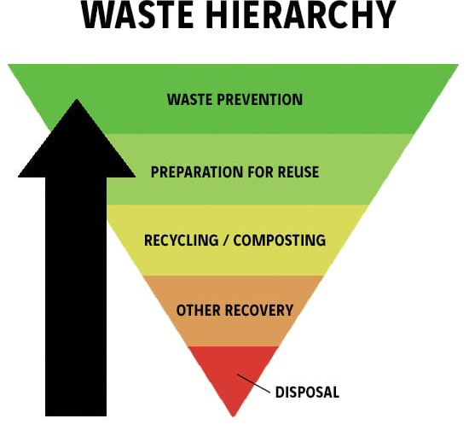
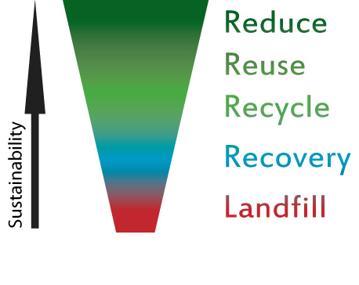

Slide 14
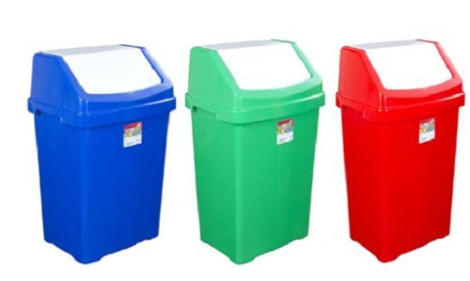
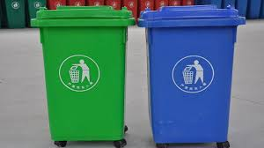
Segregation of Waste Material
Domestic Level
Community level
Blue: Non biodegradable
Green: Bio-degradable
Red: Domestic Hazard

Slide 15
Method for disposal of Solid Waste
Open Dumps
Landfills
Anaerobic Digestion
Composting/Vermicomposting
Incineration

Slide 16
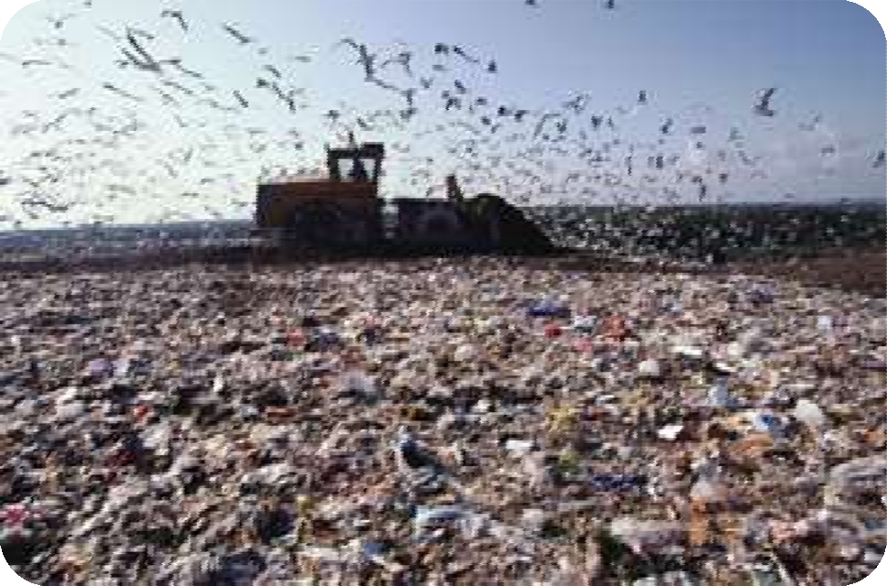
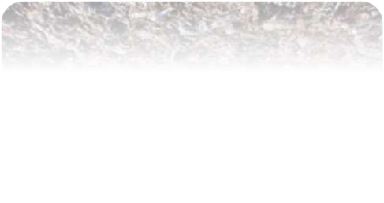


Open Dumps
Open dumps refer to uncovered areas that are used to dump solid waste of all kinds.
The waste is untreated, and not segregated.
It is the breeding ground for files, rats, and other insects that spread disease.
Figure 1: Open dump site
[Ref: Indu Shekhar Thakur- Environmental Biotechnology]
16

Slide 17
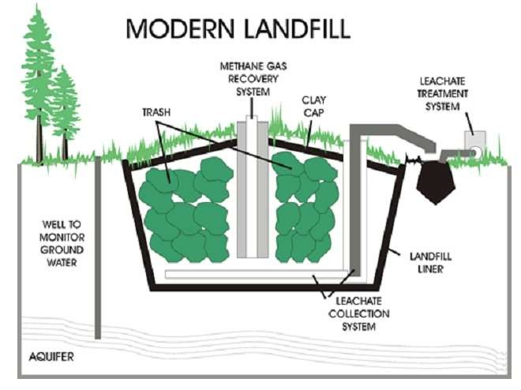
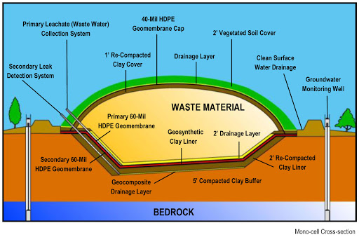
Landfills
A landfill may also refer to the ground that has been filled in with soil and rocks instead of waste materials, so that it can be used for a specific purpose, such as for building houses.
Landfill, also known as a dump or tip, is a site for disposal of waste materials by burial.
Sanitary Landfills are designed to greatly reduce or eliminate the risks that waste disposal may pose to the public health and environmental quality.
Figure 2: Modern Landfill
[Ref: Indu Shekhar Thakur- Environmental Biotechnology, T. Srinivas, Environmental Biotechnology]
17

Slide 18
Composting
Composting is the biological decomposition of organic matter under controlled aerobic conditions.
Industries as paper, agricultural and food processing give out wastes which are almost 100% organic. This organic matter can be composted to yield good manure.
Compost is the end product obtained after subjecting the organic fraction of solid waste to aerobic or anaerobic decomposition to yield humus like solid, carbon dioxide, water vapour and energy.
CO₂
H₂O
Heat
Organic waste, animal manure and bulking agent
Mixing of feedstock
Composting process
Finished Compost
Oxygen
Water
Microorganism
Figure 3: Composting mechanism
14

Slide 19
Incineration
Incineration is the most common thermal treatment process. It is burning of the waste at a temperature of 1000°C ± 100°C in the presence of oxygen so as to eliminate all odours and to ensure good combustion.
After incineration, the wastes are converted to carbon dioxide, water vapour and ash.
It converts hazardous organic substances into less hazardous components.
Anaerobic Digestion and Bio-methanation
Bio-methanation is a comparatively well-established technology for disinfections, deodorization and stabilization of sewage sludge, farmyard manures, animal slurries, and industrial sludge.
This method is suitable for only the organic biodegradable fraction of MSW; it does not degrade any complex organics or oils, grease, or ligno-cellulosic materials such as yard waste. Incineration.
This method, commonly used in developed countries is most suitable for high calorific value waste with a large component of paper, plastic, packaging material, pathological wastes, etc.

Slide 20
IMPACTS OF WASTE
Affects our health
Affects our socio-economic conditions
Affects our coastal and marine environment
Affects our climate
GHGs are accumulating in Earth’s atmosphere as a result of human activities, causing global mean surface air temperature and subsurface ocean temperature to rise.
Rising global temperatures are expected to raise sea levels and change precipitation and other local climate conditions.
Changing regional climates could alter forests, crop yields, and water supplies.
This could also affect human health, animals, and many types of ecosystems.

Slide 21
The type of litter we generate and the approximate time it takes to degenerate
Type of litter | Approximate time it takes to degenerate the litter
Organic waste such as vegetable and fruit peels, leftover foodstuff, etc | 30-90 days
Paper | 10–30 days
Cotton cloth | 2–5 months
Wood | 10–15 years
Woolen items | 1 year
Tin, aluminum, and other metal items such as cans | 100–500 years
Plastic bags | one million years
Glass bottles | undetermined

Slide 22
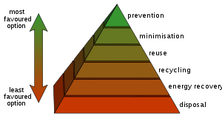
Management of Solid waste
The fundamental objective of waste processing is to reduce the amount of wastes through recycling and disposal of waste in a way not to impair environmental conservation.
Four R’s should be followed for waste management:
Reduce
Reuse
Recycle
Recover
Figure 4: Waste hierarchy
[Ref: Indu Shekhar Thakur- Environmental Biotechnology]

Slide 23
Thank you

